Slide 1
Kevin O’Leary
LIVE in Mississauga
Saturday, May 26, 2018
9:00 am – 12:00 pm
Notes:
A Wealth Retreat Event held at Hilton Toronto Airport Hotel & Suites, Mississauga

Slide 2
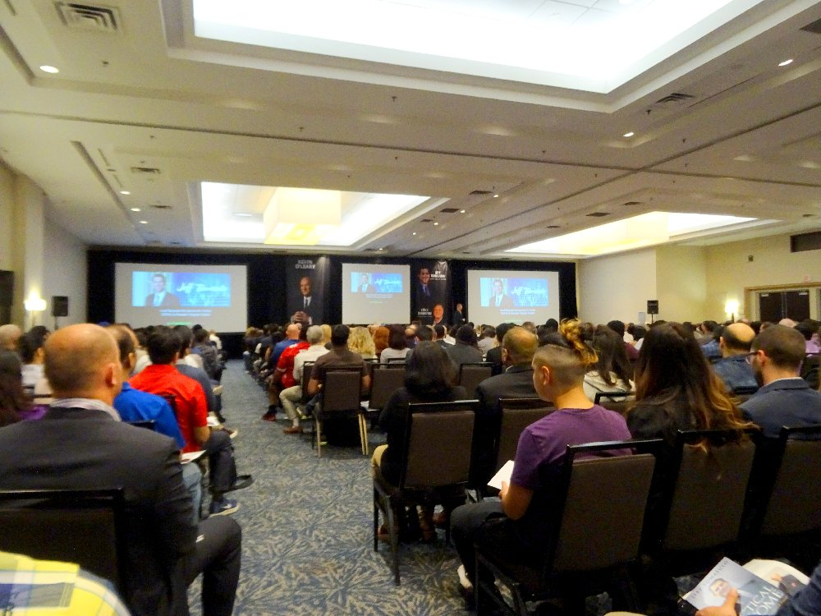
Full house at Hilton Toronto Airport Hotel & Suites, 5875 Airport Rd. Mississauga ON L4V 1N1

Slide 3
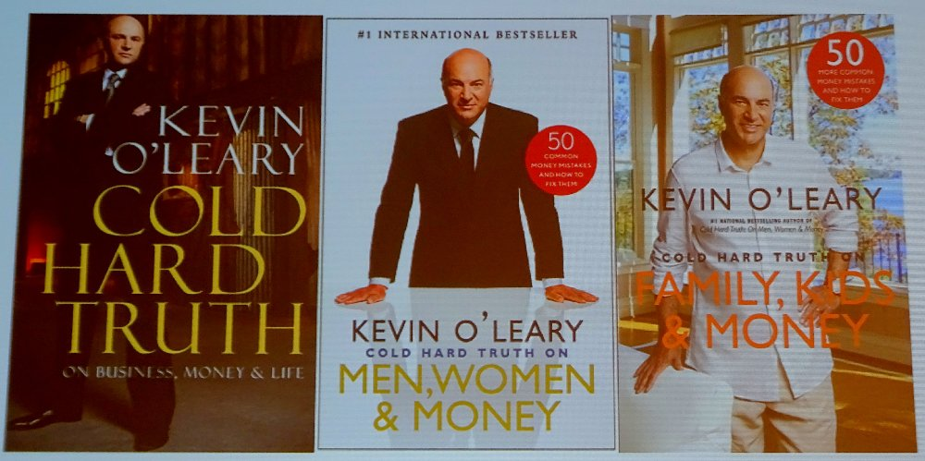
Books by Kevin O’Leary

Slide 4
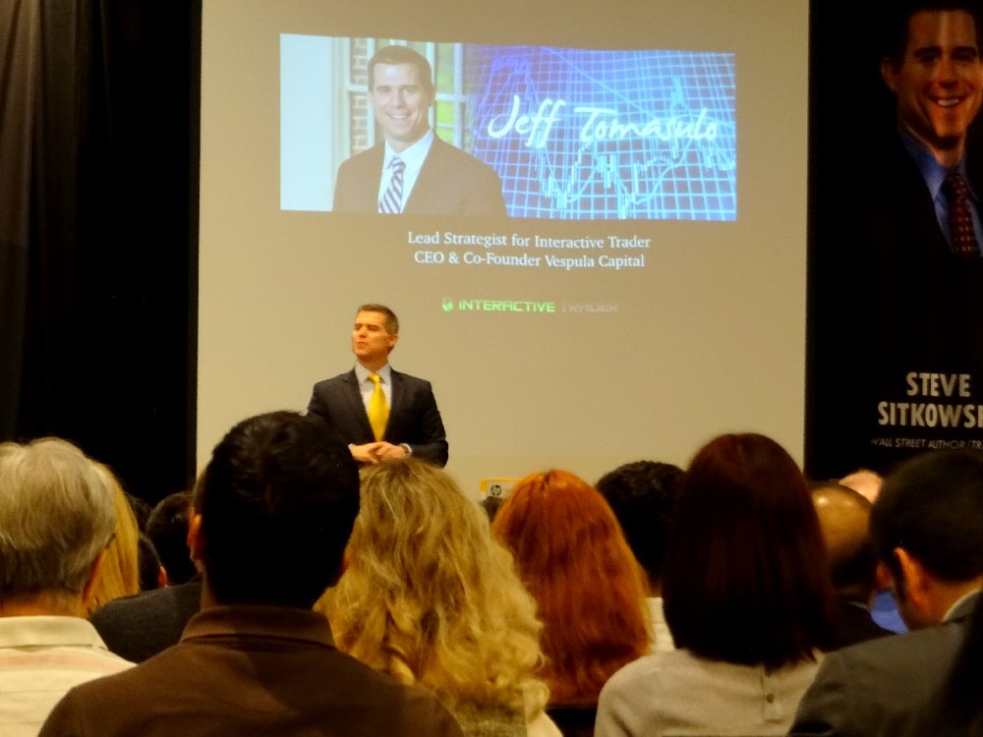
Jeff Tomasulo, CEO & Co-Founder of Vespula Capital, speaks

Slide 5
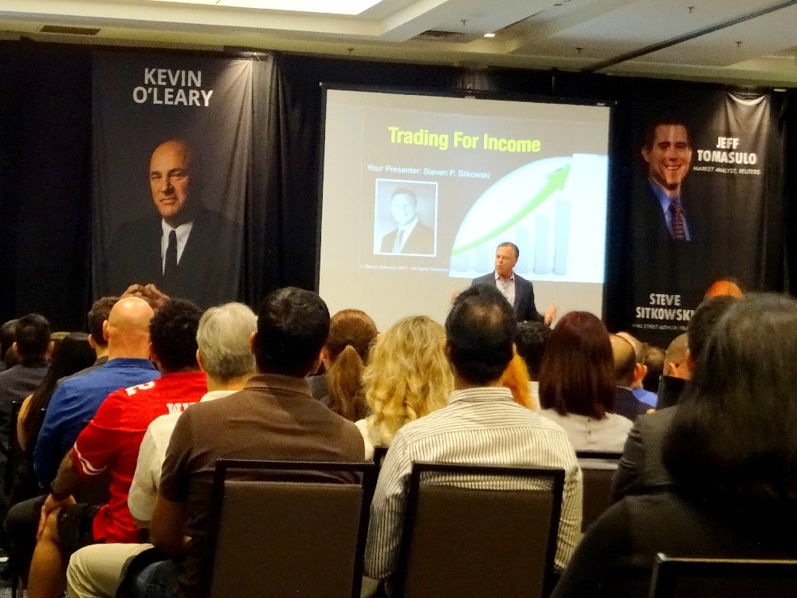
Steven P. Sitkowski, Founder at Pro Trader Institute, speaks
Notes:
Steven P. Sitkowski, Founder at Pro Trader Institute, speaks

Slide 6
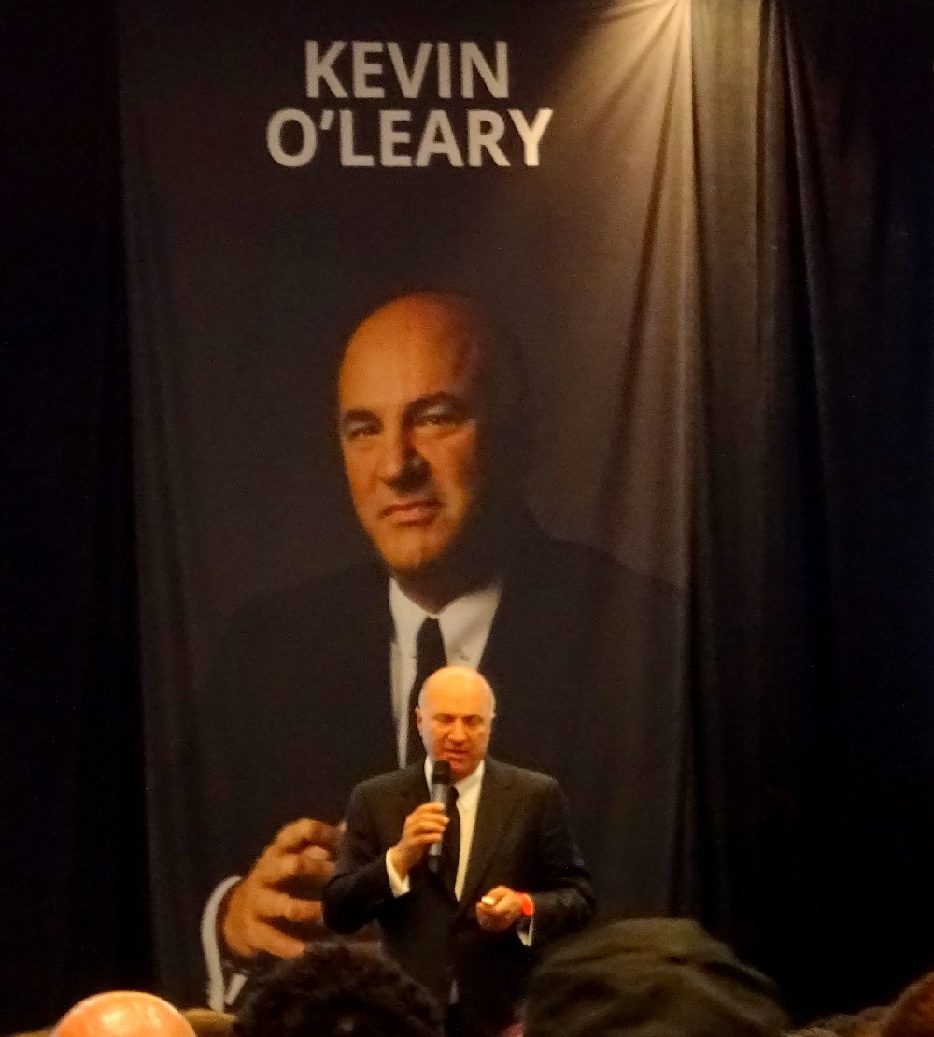
Kevin O’Leary speaks to us - LIVE in Mississauga
Notes:
“Mr. Wonderful” Kevin O’Leary speaks to us - LIVE in Mississauga

Slide 7
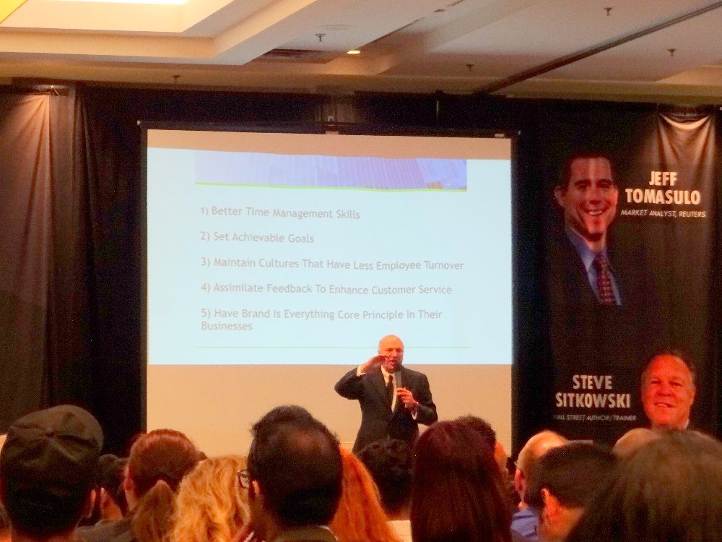
Kevin O’Leary speaks on Better Time Management Skills
Notes:
Kevin O’Leary speaks on Better Time Management Skills

Slide 8
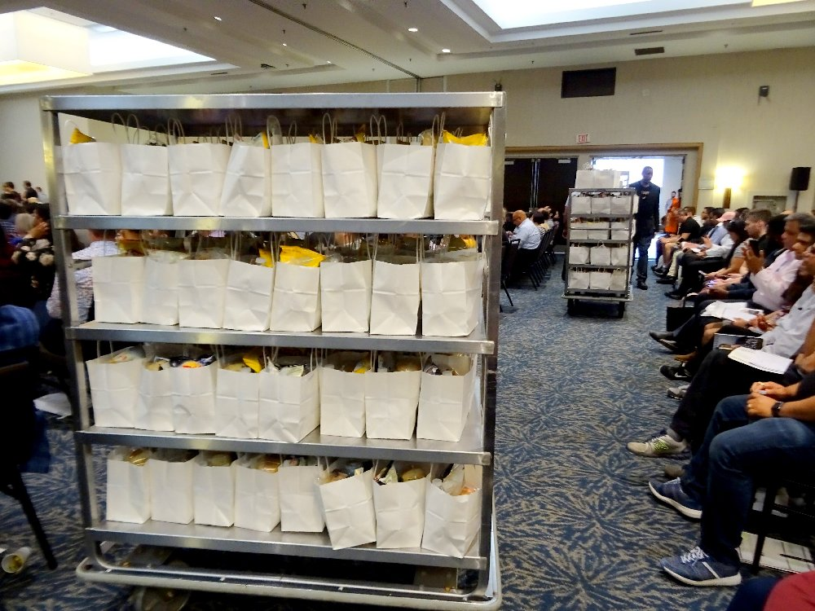
Surprise lunch bags arrive for all attendees.
Notes:
Surprise lunch bags arrive for all attendees.

Slide 9
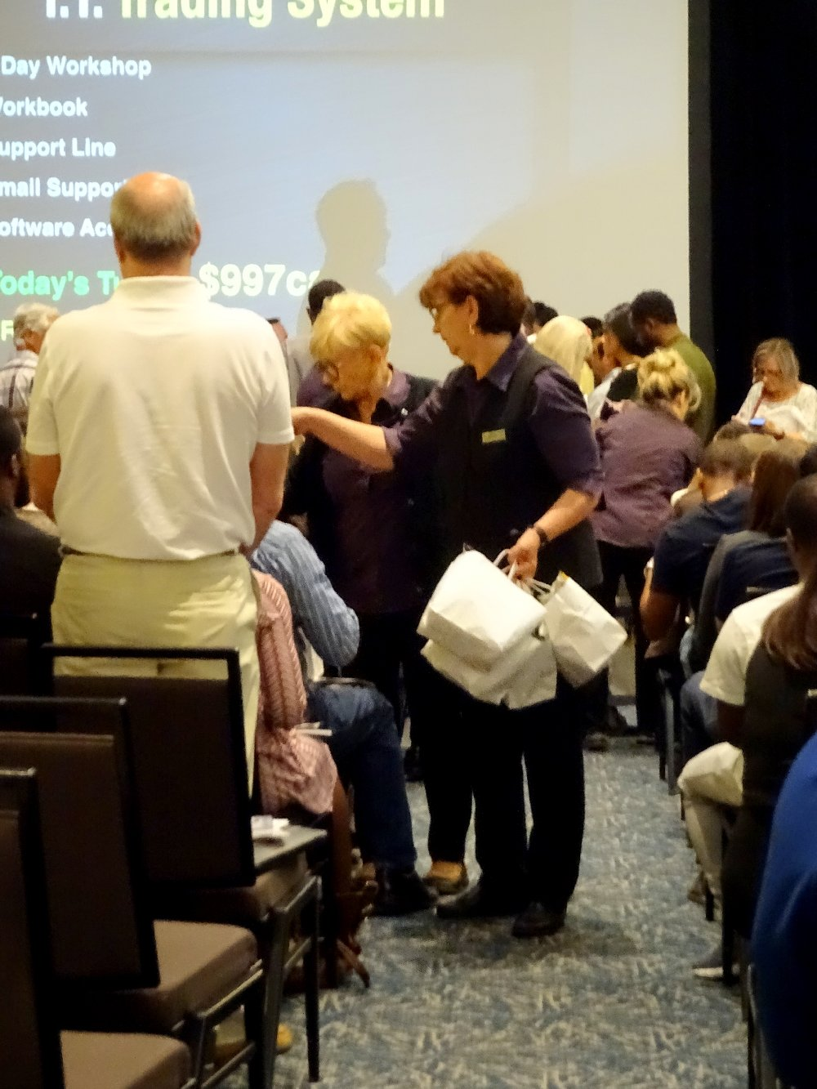
Helpers personally deliver one lunch bag to every single attendee
Notes:
Helpers personally deliver one lunch bag to every single attendee (2 sandwiches, potato salad, apple, chips, bottled water, napkins and cutlery in each bag)

Slide 10
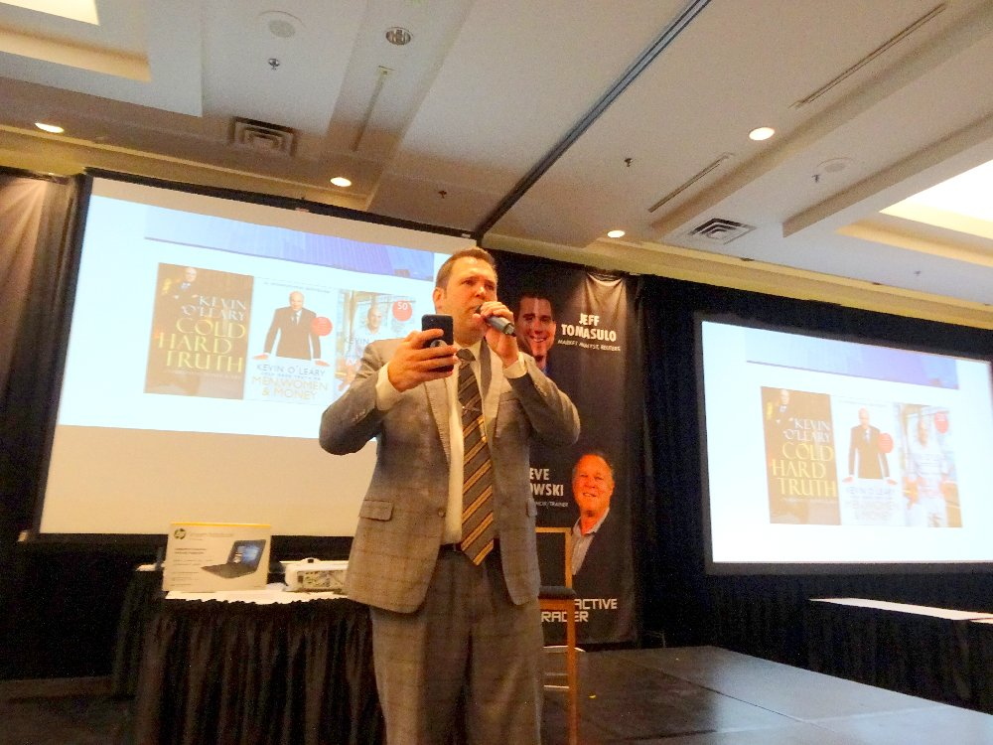
Master of Ceremony announces door prize winners
Notes:
Master of Ceremony announces door prize winners

Slide 11
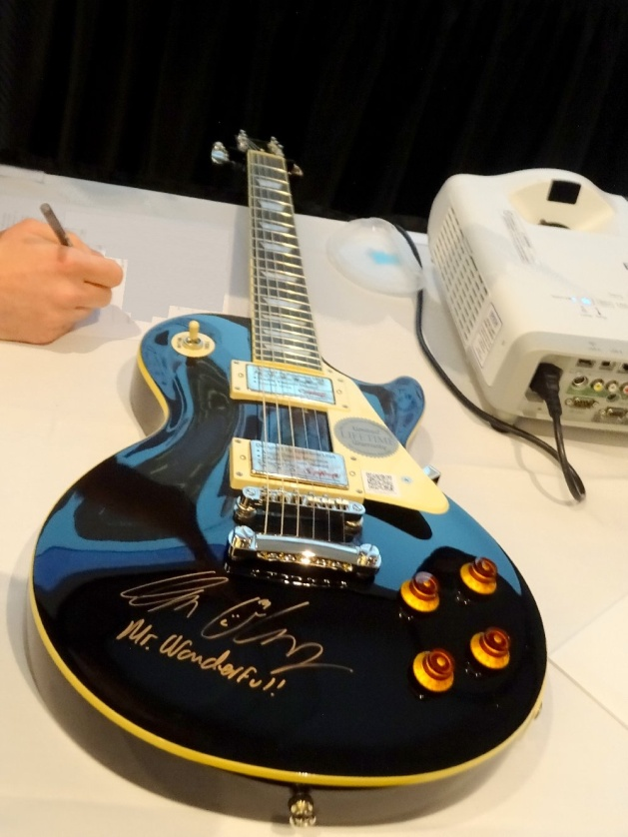
This beautiful brand new guitar (signed by Kevin O’Leary, Mr. Wonderful himself) is one of the door prizes.
Notes:
This beautiful brand new guitar (signed by Kevin O’Leary, Mr. Wonderful himself) is one of the door prizes.

Slide 12
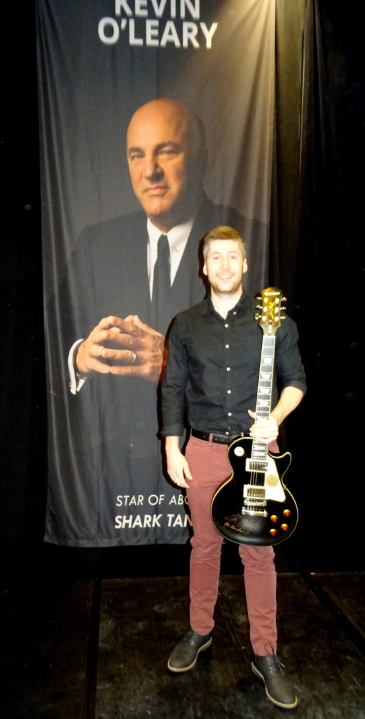
And the lucky winner of the guitar is Zachary Sabean. Congratulations, Zachary!

Slide 13
THANK YOU
A big thank-you to organizers of this wonderful event - one of Wealth Retreat Events. It was very educational and enjoyable. The speakers talked about the stock market and explained the various trading terms. The investment tips that Kevin O’Leary gave us were inspirational. Many people signed up to learn more.
The Hotel parking lot was so full that many of us who arrived 15-minutes early had to park far away on an adjacent street. Moral of the story: Don’t arrive on time, arrive at least 30 minutes or 1 hour early for an event such as this.

